Slide 1



Adaptive Traffic Signal Optimization Using YOLOv26 Object Detection and PCE-Weighted Fuzzy Logic
Tengku Rifandi Dimas A · Karli Eka Setiawan · Pareendeep Kaur · Satriadi Putra Santika · Tobias Nevanael Taas
CBina Nusantara University, Jakarta, Indonesia 11480
Notes:
1

Slide 2
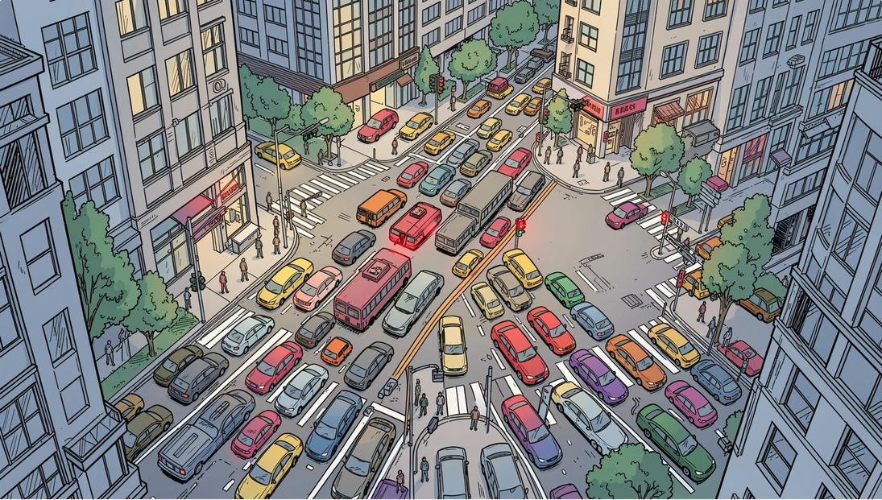

INTRODUCTION
The Urban Traffic Crisis
Rapid urbanization and population growth have overwhelmed traditional infrastructure. Fixed-time traffic signals ignore real-time vehicle density, causing:
Economic Loss
Environmental Damage
Wasted fuel and productivity from idling vehicles
Increased CO₂ emissions from unnecessary stops
Driver Frustration
Green lights on empty lanes while others queue
Notes:
2

Slide 3
RELATED WORKS
What Exists & What's Missing
YOLO Frameworks
Fuzzy Logic
YOLOv8 is widely studied but faces occlusion problems — larger vehicles hide smaller ones in heavy congestion, rain, or fog.
Translates vehicle counts into low/medium/high density categories, enabling robust timing decisions even with detection noise.
Reinforcement Learning
Research Gap
Computationally intensive and not yet field-deployed; fuzzy logic is more stable and interpretable for agencies.
Most prior work uses older YOLO versions and idealized Western datasets — not heterogeneous Asian traffic conditions.
Notes:
3

Slide 4
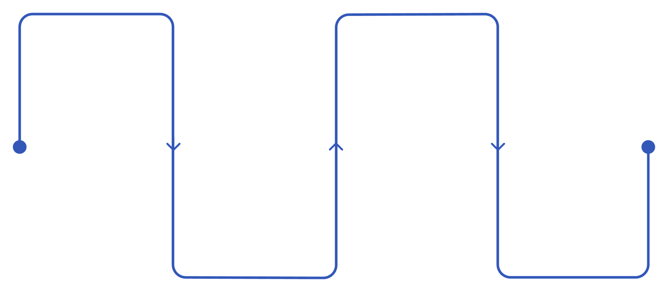
METHODOLOGY
Our Solution: YOLOv26 + PCE-Weighted Fuzzy Logic
Detect
Classify
YOLOv26 finds vehicles in real-time
Fuzzy logic rates density Low/Medium/High
Convert
Control
Translate counts to PCE-weighted values
Output optimal green duration in seconds
YOLOv26 is the latest evolution in the YOLO series — engineered for edge devices with streamlined architecture, removing unnecessary complexity while delivering faster, lighter deployment. Fuzzy logic handles uncertainty by treating congestion as a spectrum, not just empty or full, and dynamically scales green time based on actual demand.
Notes:
4

Slide 5
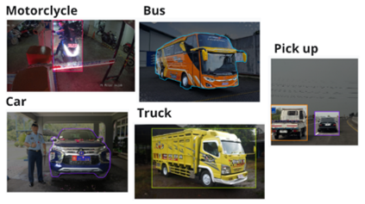
METHODOLOGY
Dataset & Exploratory Data Analysis
Dataset Overview
EDA Findings
Open-source Indonesian vehicle dataset from Roboflow (Arkhsat Project)
Unlike traditional traffic repositories with severe class imbalances, this dataset maintains a balanced footprint — every category (bus, truck, car, motorcycle, pickup) safely exceeds 2,000 instances. This structural homogeneity avoids majority-class bias in YOLOv26, ensuring reliable density data for the fuzzy logic controller.
10,500+
5 Classes
HD
Total Images
Pickup, Bus, Car, Motorcycle, Truck
High Definition JPEG
Notes:
5

Slide 6
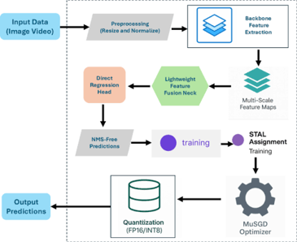
METHODOLOGY
YOLOv26 Architecture & Preprocessing
Why YOLOv26 Nano?
Best speed-accuracy trade-off for edge deployment. Key components:
  Backbone — feature extraction
  Feature Fusion Neck — multi-scale learning
  Direct Regression Head — efficient prediction
  STAL assignment + MuSGD optimizer — boosted training
  FP16/INT8 quantization — faster real-time inference
Preprocessing is automated by Ultralytics: letterbox padding, mosaic stitching, horizontal flips, and color modifications simulate varied road conditions and occlusion scenarios.
Notes:
6

Slide 7

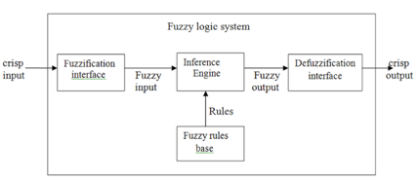
METHODOLOGY
PCE-Weighted Fuzzy Logic Controller
Passenger Car Equivalent (PCE)
Fuzzy Logic Architecture
Assigns weights per vehicle type (MKJI 1997 standard) for accurate congestion measurement in heterogeneous Indonesian traffic:
01
Fuzzification
PCE density → fuzzy values (Low/Medium/High)
02
Inference
Apply rule base to fuzzy inputs
03
Rule Evaluation
Determine applicable green duration rules
04
Defuzzification
Output crisp green light duration (seconds)
Motorcycle
Light Vehicle
Heavy Vehicle
0.25
1.0
1.3
Notes:
7

Slide 8
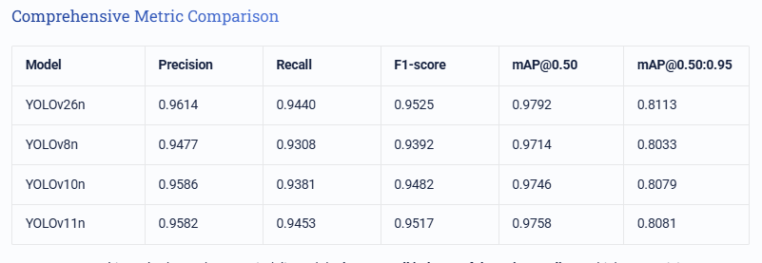
RESULTS
Model Comparison & Detection Performance
Why YOLOv26n Won
Highest precision (0.9614) and best localization accuracy (mAP@0.50:0.95 = 0.8113) among all compared models.
While YOLOv11n achieved the highest recall (0.9453) and F1-score (0.9517), YOLOv26n was selected for its superior overall accuracy — critical for precise traffic density estimation and adaptive signal control.
Notes:
8

Slide 9
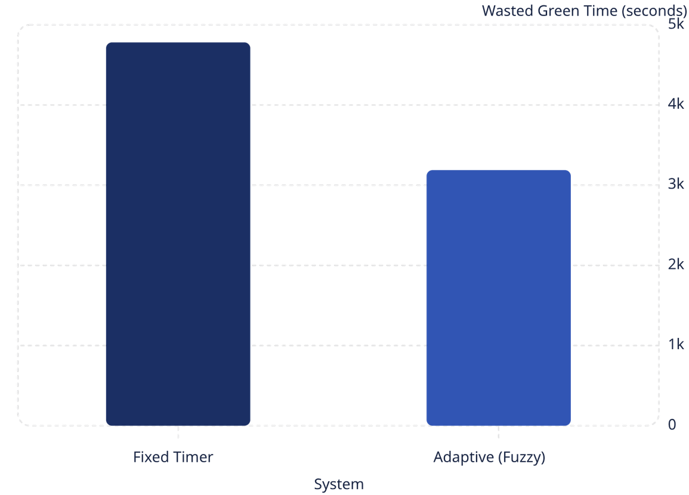


RESULTS
Adaptive System vs. Fixed Timer
Key Findings
33.3% Reduction
Dynamic Scaling
Wasted green time dropped from 4,781s → 3,188s
Fuzzy system concentrates green phases around 20–21 seconds, cutting off as demand declines
Edge Latency: 3.2ms
Throughput Trade-off
Outperforms YOLOv8n (8.5ms) and Faster R-CNN (45.0ms) on edge devices
YOLOv26n: 80.1 FPS on Tesla T4 — slower than YOLOv8n (115.5 FPS) but highest detection accuracy
Notes:
9

Slide 10
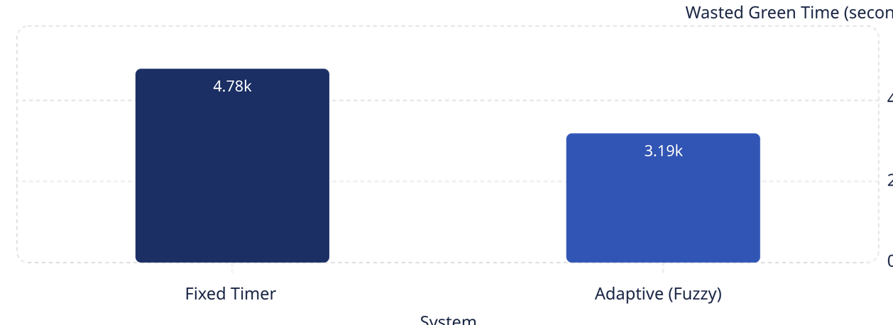

RESULTS
Wasted Green Time Reduction
Column chart comparing Fixed Timer (4,781 seconds) vs Adaptive Fuzzy (3,188 seconds) wasted green time.
Key findings:
33.3% Reduction
Adaptive Advantage
Adaptive control cut wasted green time by nearly a third.
Green time was used more efficiently, reducing idle periods and improving responsiveness.

Slide 11
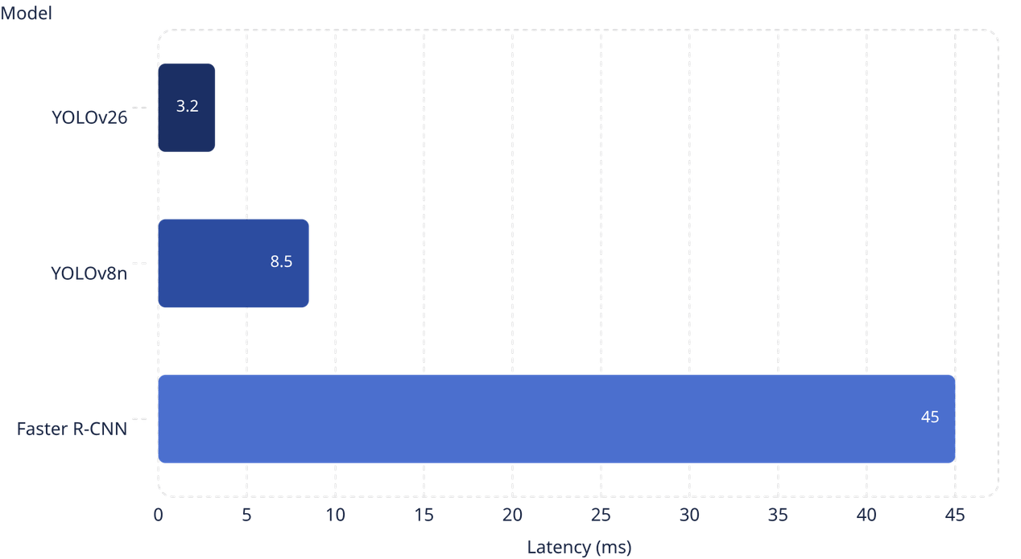
RESULTS
Inference Latency on Edge Device
YOLOv26 is the fastest model at 3.2 ms, making it the best fit for real-time edge control. That speed is critical for reacting quickly to live detector updates and keeping traffic signal decisions current.

Slide 12
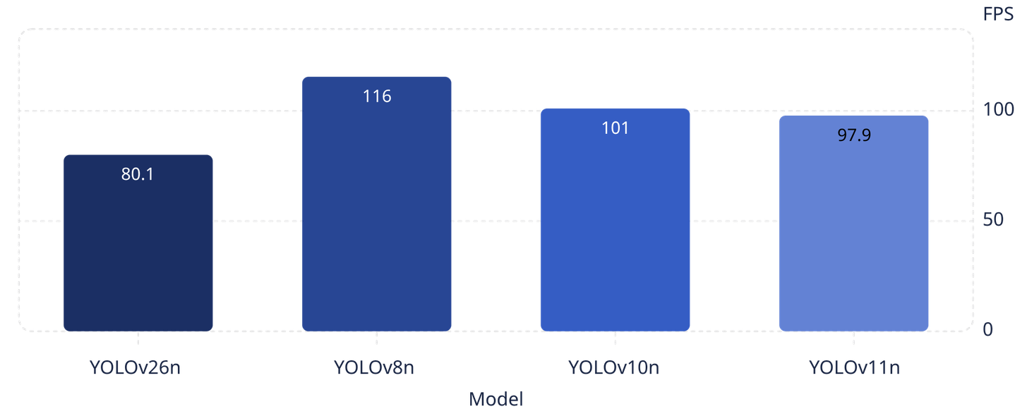
RESULTS
Model Throughput Comparison on Tesla T4 GPU
YOLOv26n processes 80.1 frames per second, which is slower than YOLOv8n at 115.5 FPS. However, for traffic control, accuracy is more important than speed. Better detection quality means better traffic decisions.

Slide 13

CONCLUSION
Conclusion & Future Work
Limitations & Future Work
What We Achieved
Real-World Deployment
  YOLOv26n achieved 0.9614 precision and 0.8113 mAP@0.50:0.95 on Indonesian vehicle dataset
  PCE-weighted fuzzy logic reduced wasted green time by 33.3% vs. fixed timers
  Edge inference at 3.2ms — suitable for real-time deployment
  Scalable, responsive framework for smart city congestion management
Validate on actual urban infrastructure beyond simulation
Multi-Intersection Sync
Coordinate signals across multiple intersections
Additional Sensors
Integrate radar and thermal cameras for all-weather robustness
CAV Integration
Enhance fuzzy logic for connected and autonomous vehicles
Notes:
10

Slide 14
Thank You
We appreciate your time and attention. Here are some resources for further exploration.
Code Link
Dataset

